Slide 1
Regional youtube Recommendation System

Slide 2

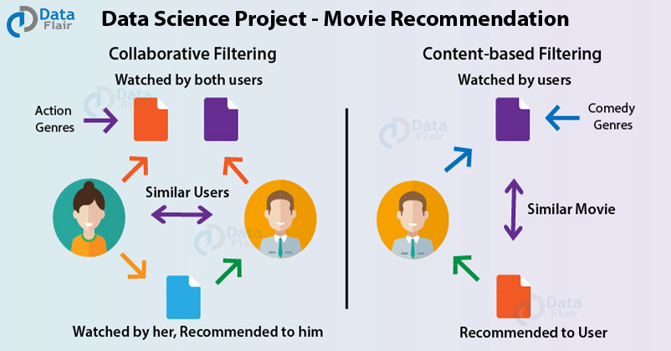
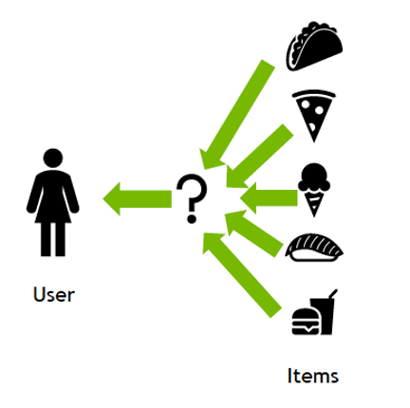
What are Recommendation Systems ?
A recommendation system can be thought of as a subclass of information filtering system.
Having a recommendation engine makes browsing content easier.
Helps users find things they wouldn't have thought to look for on their own.

Slide 3







Technology stack

Slide 4
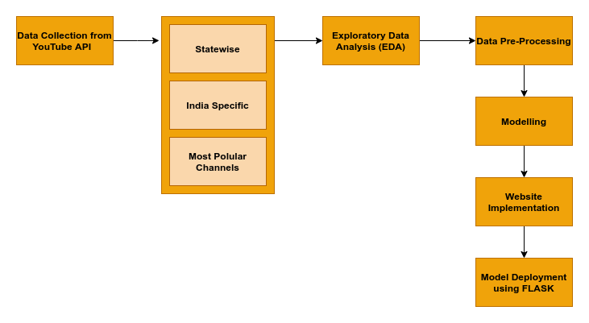

Project Architecture

Slide 5
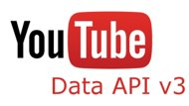
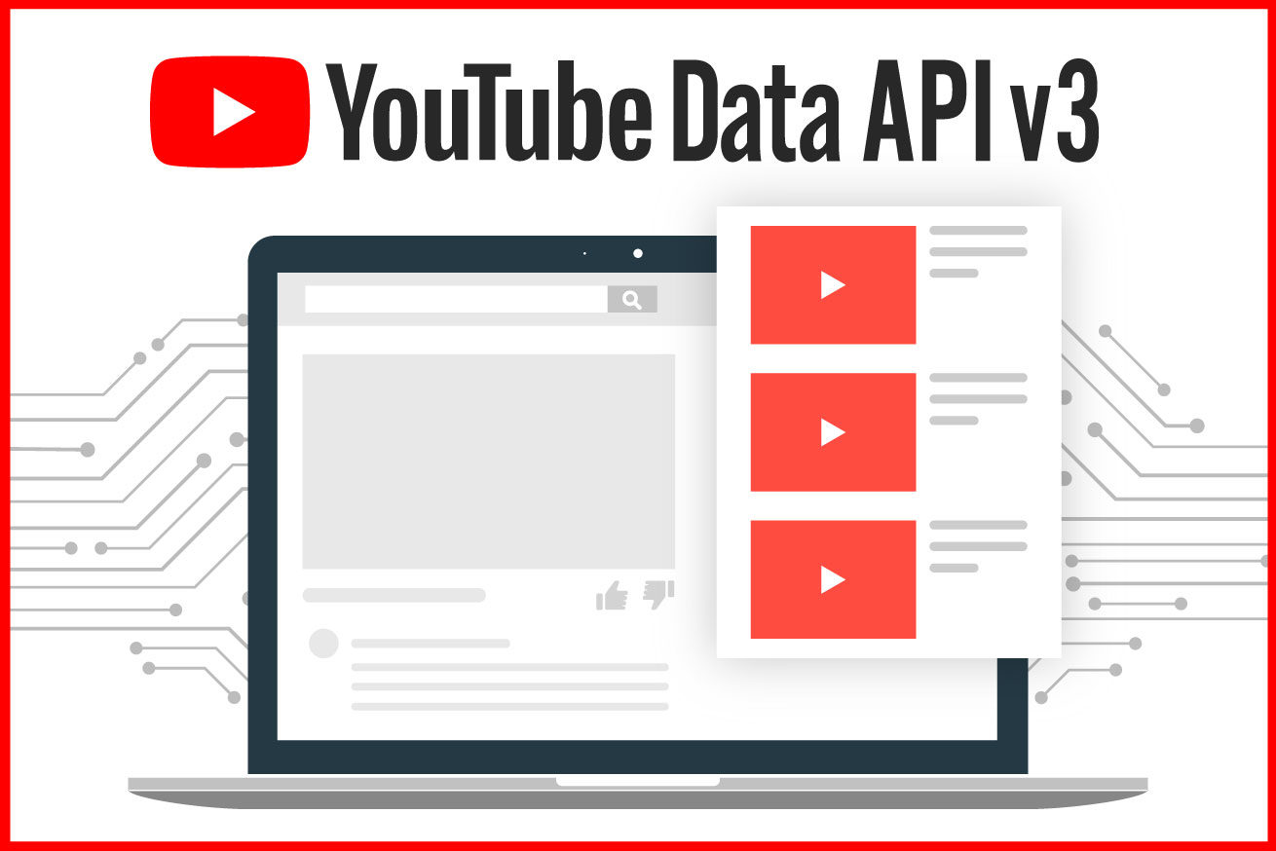
YOUTUBE API
The YouTube Application Programming Interface (YouTube API) allows developers to access video statistics and YouTube channels data via two types of calls, REST and XML-RPC. Google describe the YouTube API Resources as "APIs and Tools that let you bring the YouTube experience to your webpage, application or device."
We gather YOUTUBE DATA using YOUTUBE API

Slide 6
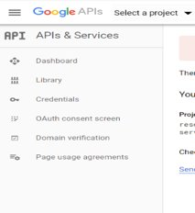
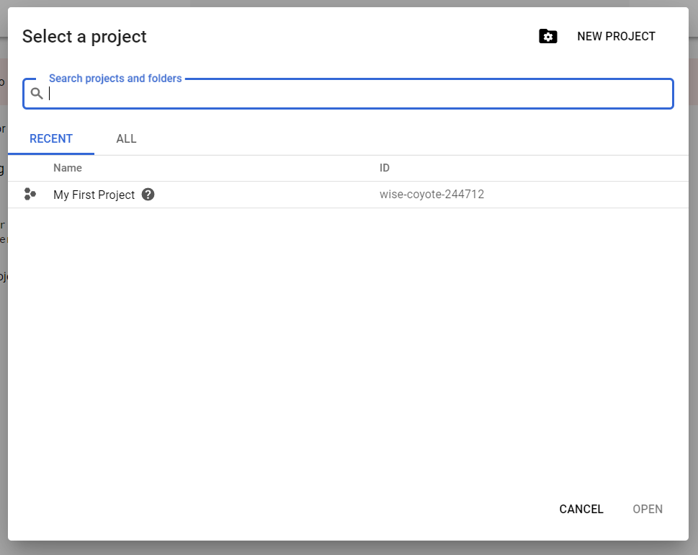
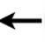
STEPS TO CREATE YOUTUBE API USING GOOGLE DEVELOPER DASHBOARD
Create a new project on google developer dashboard
Click on new project

Slide 7
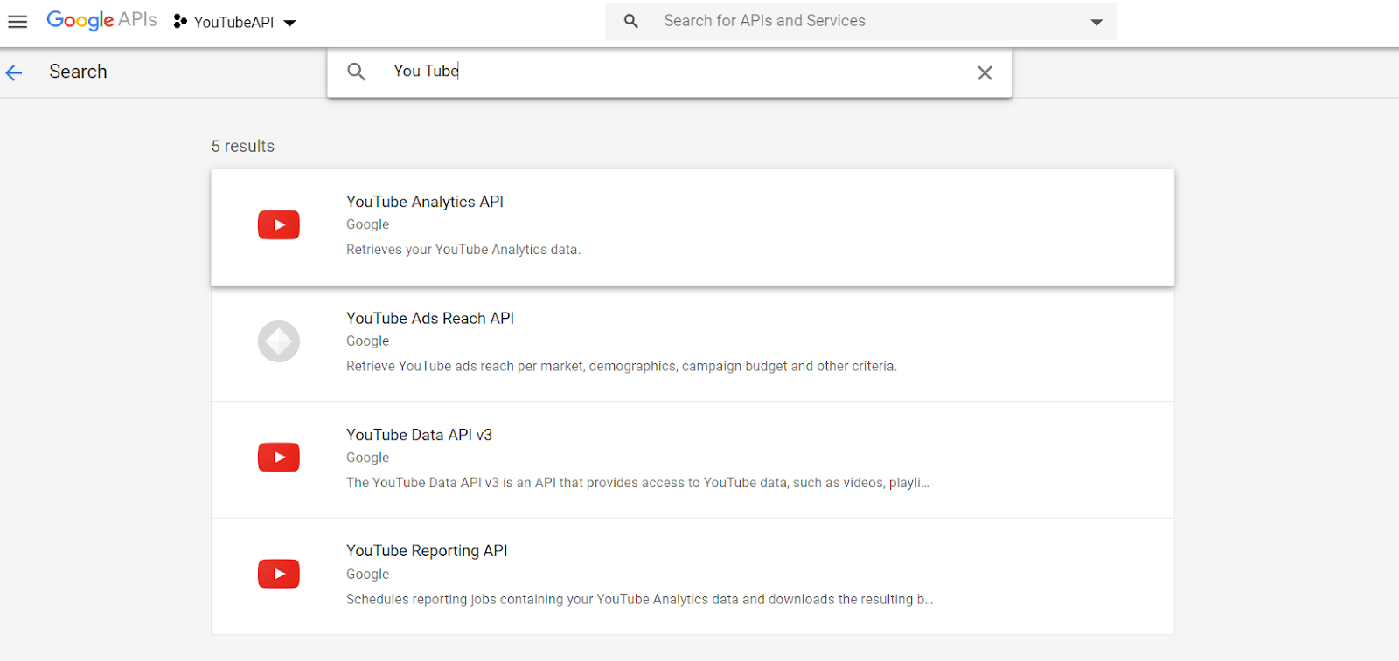
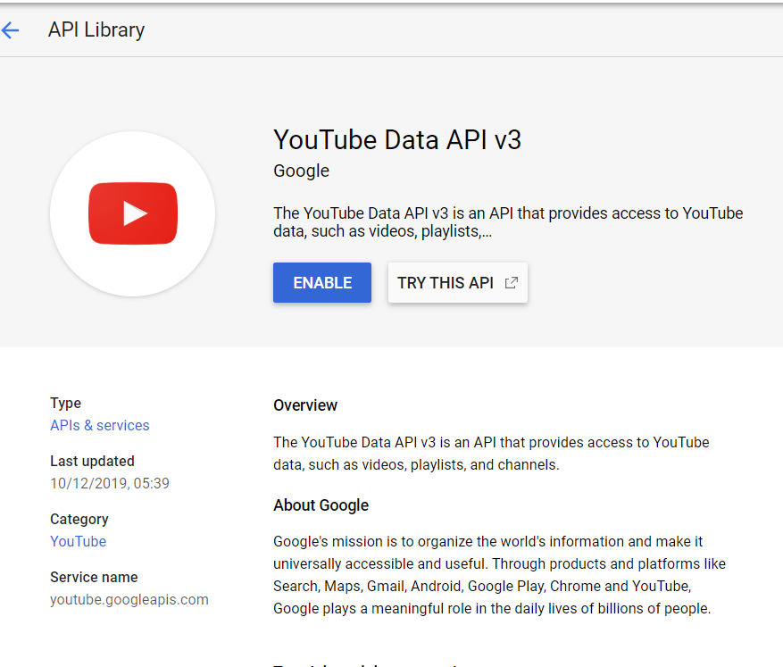
you will be automatically redirected to the Google APIs dashboard.
Search for YouTube Data API v3 on API and services
Enable the API by clicking on the Enable

Slide 8
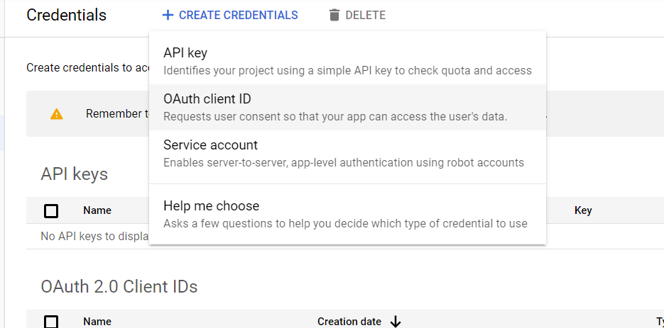
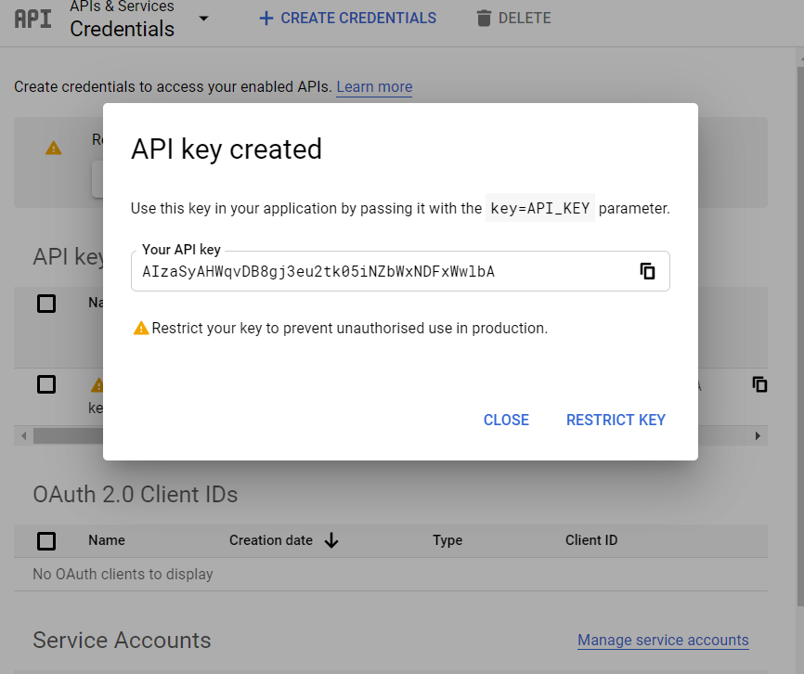
A unique API
will be created
select on credentials then from create credentials select API key
API Key Created
then copy the API Key and use it to extract YouTube data

Slide 9
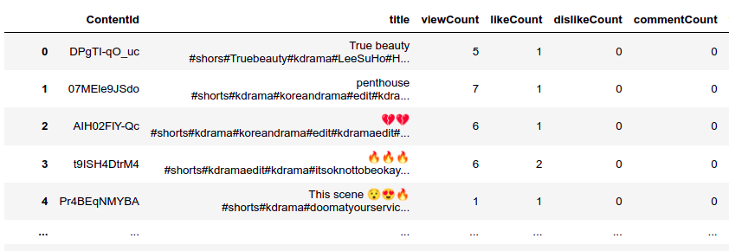
Type of Data Included from YouTube API
Most popular videos according to Indian Region.
Videos according to the most searched keywords on YouTube based on location (State Wise Data).
Videos according to the most popular channels on YouTube.
From all the above categories the list of video data frame is prepared containing below features using id, snippet, contentDetails, statistics, topicDetails.
List of Features

Slide 10
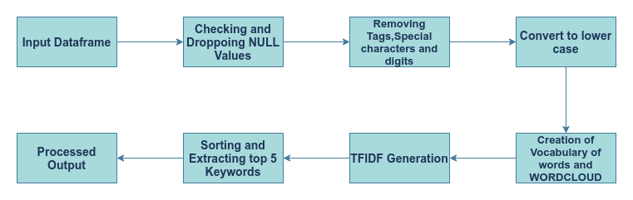
Pre-processing

Slide 11
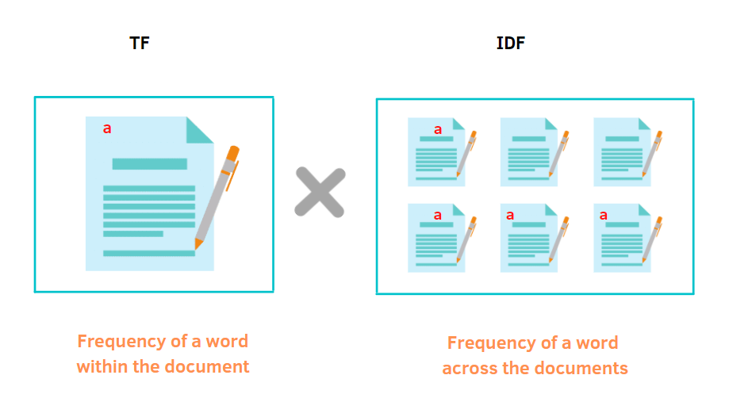
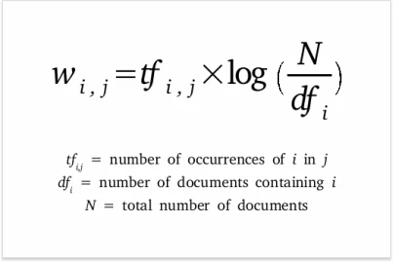
Keyword Extraction using tf-idf
TF-IDF (term frequency-inverse document frequency) is a statistical measure that evaluates how relevant a word is to a document in a collection of documents.

Slide 12

Exploratory Data Analysis
Exploratory Data Analysis (EDA) - is a way to investigate datasets and find preliminary information, insights, or uncover underlying patterns in the data. Instead of making assumptions, data can be processed in a systematic method to gain insights and make informed decisions.
Data characteristic:
Data Size: 5.37 GB
Data point count: 3.3M records
Indian States & UTs considered: 32
No of features: 11 [ContentId, title, viewCount, likeCount, dislikeCount, commentCount, favoriteCount, publishedAt, description, duration, tags]

Slide 13
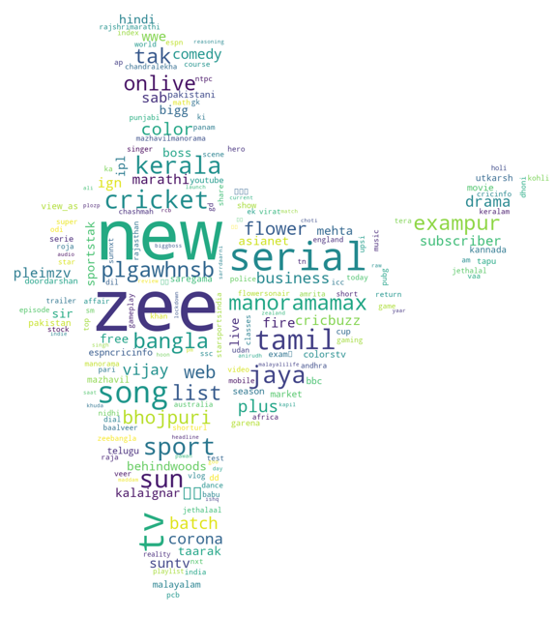
Overall India data EDA
Data characteristic:
Data Size: 1.1 GB
Data point count: 680,473 records
Keywords: Zee, new, Serial, song, sport, tamil, jaya.

Slide 14
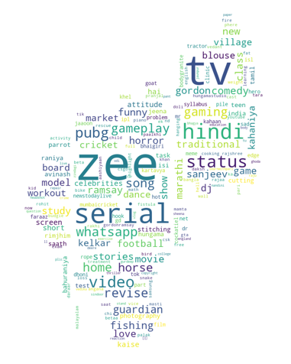
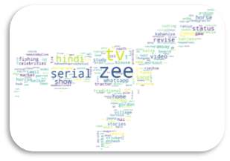
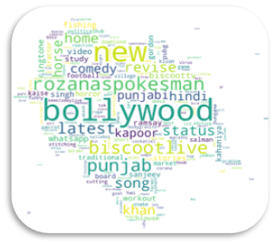
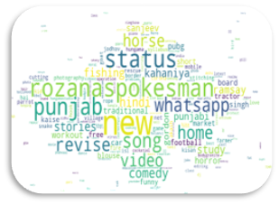
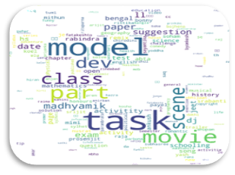
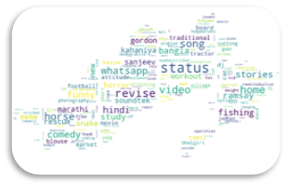
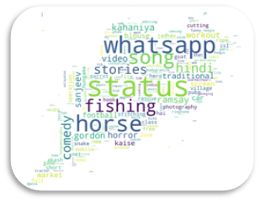
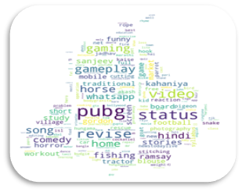
Indian state data EDA
Tripura
Assam
Himachal Pradesh
Rajasthan
Punjab
Andaman and Nicobar Islands
Arunachal Pradesh
Odisha
https://github.com/TeamEpicProjects/Recommendation-System-for-YT/tree/main/data/processed/IndianStateWordCloud.zip

Slide 15
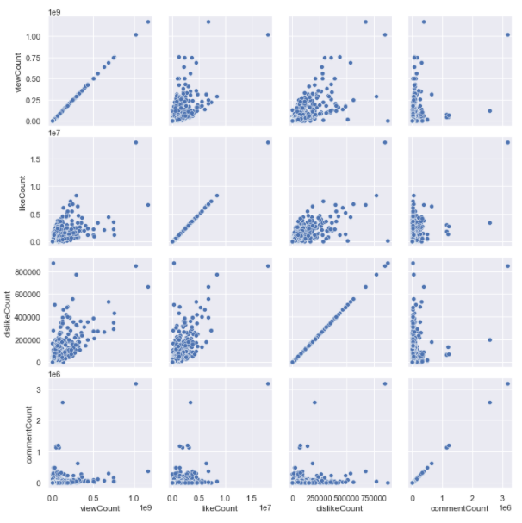
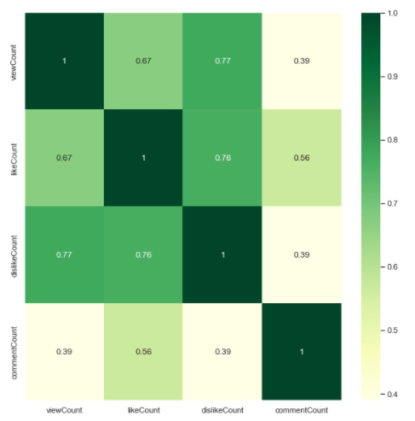
Overall India data EDA
Data characteristic:
Data Size: 1.1 GB, Data point count: 680,473 records
Dislike count is highly co-related with view count and like count. Hence, Video with higher viewership use to get high like and dislike

Slide 16
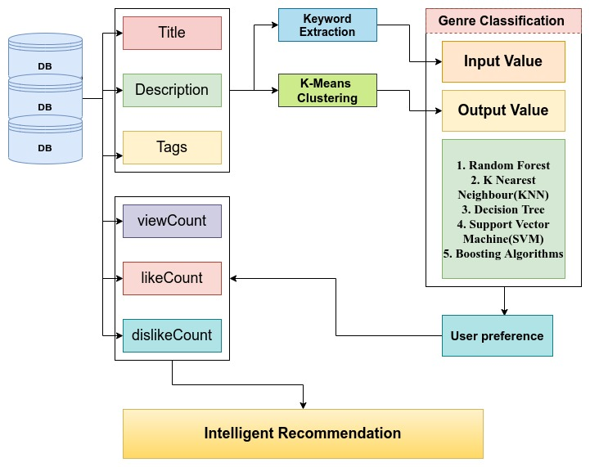
Model Architecture

Slide 17
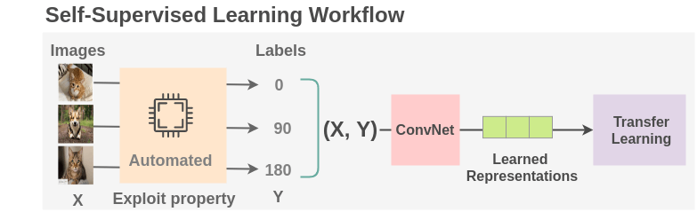
Type of Learning used in RS - Self Supervised Learning
Method of machine learning that can be regarded as an intermediate form between supervised and unsupervised learning.
It is a type of autonomous learning using artificial neural networks that does not necessarily require sample data classified in advance by humans.

Slide 18

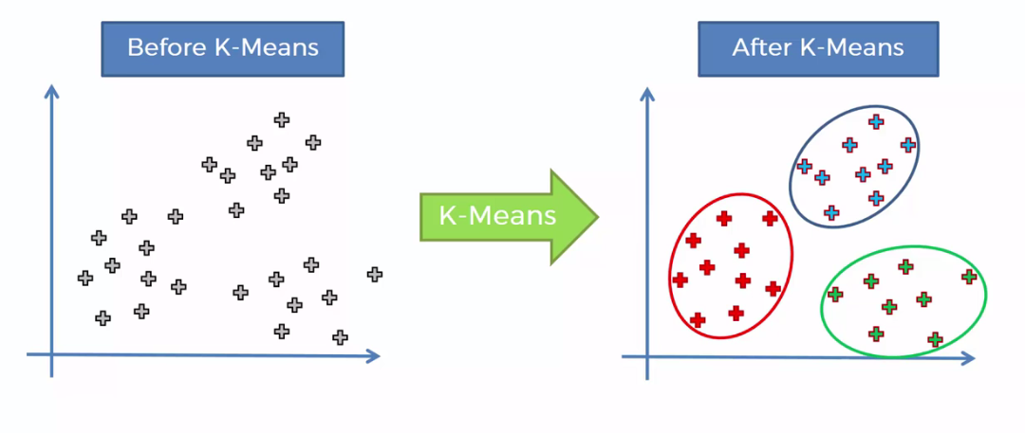
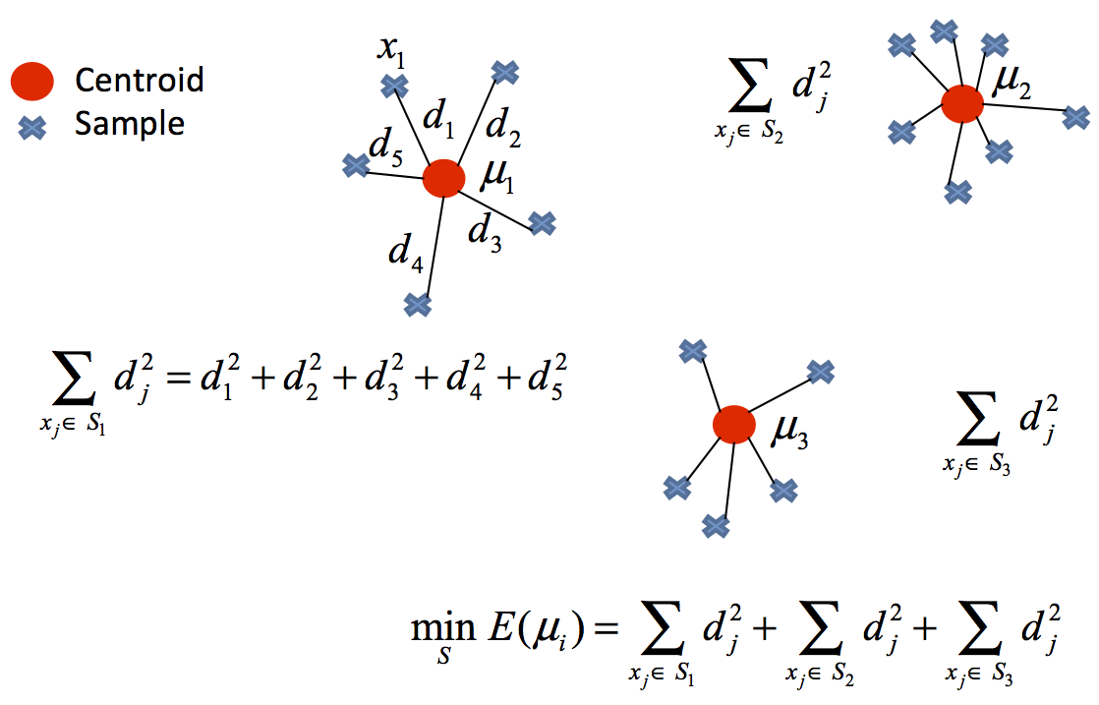
K Means Clustering
K-Means Clustering is an Unsupervised Learning algorithm, which groups the un-labeled dataset into different clusters. Here K defines the number of pre-defined clusters that need to be created in the process, as if K=2, there will be two clusters, and for K=3, there will be three clusters, and so on.

Slide 19
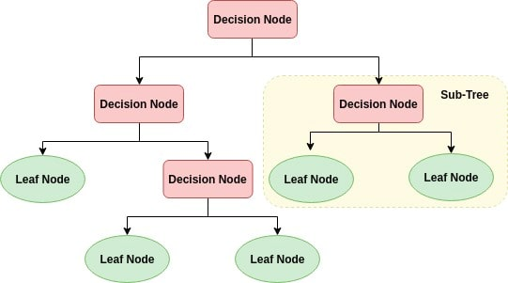
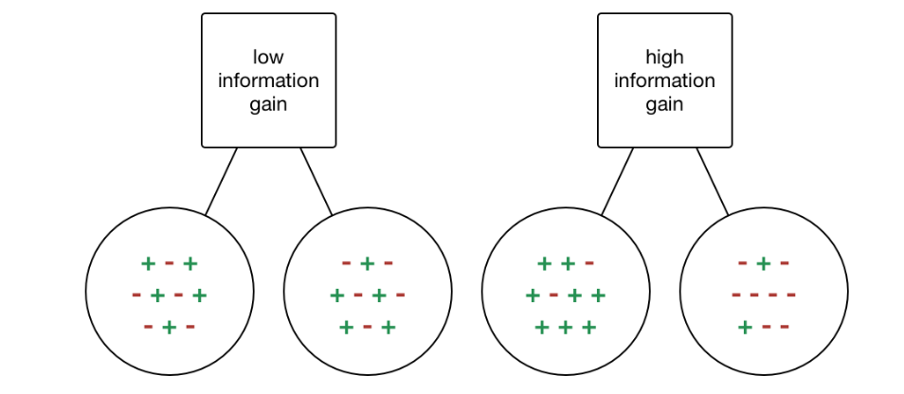
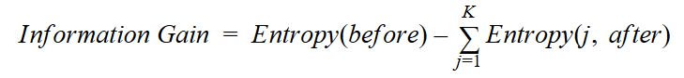
Decision Tree
Decision Tree is a Supervised Machine Learning Algorithm that uses a set of rules to make decisions, similarly to how humans make decisions. It is a tree-structured classifier, where internal nodes represent the features of a dataset, branches represent the decision-rules and each leaf node represents the outcome.
Information gain or IG is a statistical property that measures how well a given attribute separates the training examples according to their target classification.

Slide 20
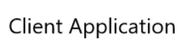


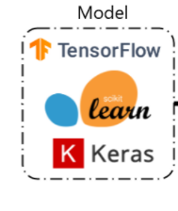

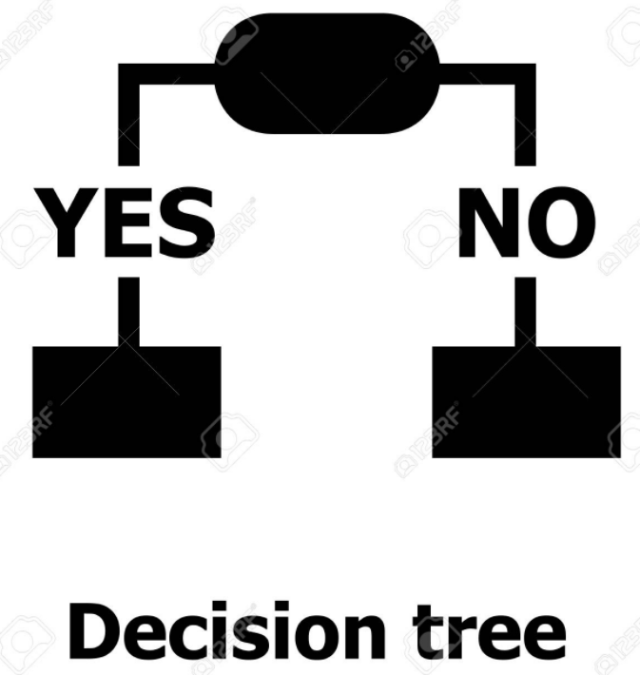
Model deployment using flask
keyword entered by the user is sent to model
keyword received is used to recommend 10 videos
10 recommended videos are being displayed to the user
returns the 10 recommended videos back to the UI

Slide 21
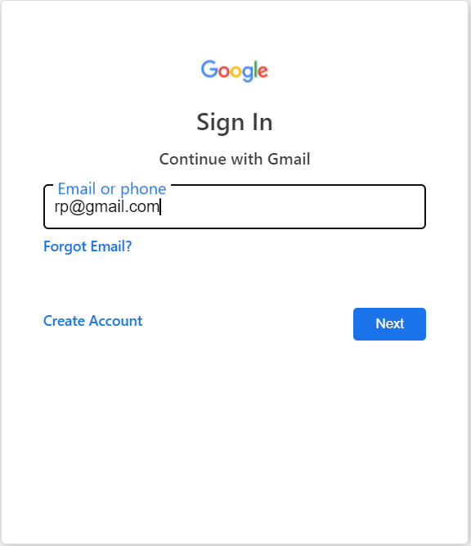
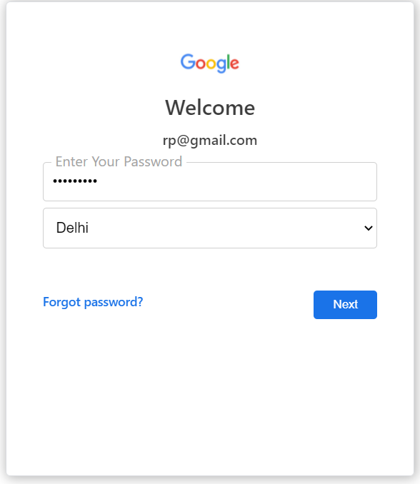
User interface
Enter the password and choose the state from the dropdown and press next to land on the main YouTube page.
Enter the email id or phone number to login to the YouTube and press next

Slide 22
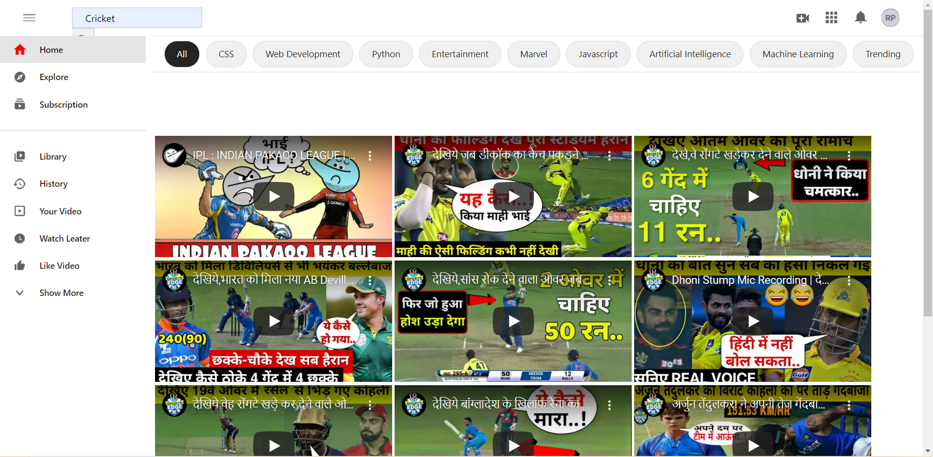

Once landed on the main page enter the keyword and hit the search button to get top 10 recommended videos on the page.

Slide 23
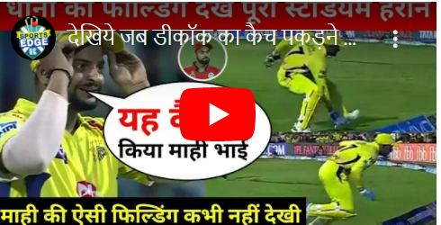
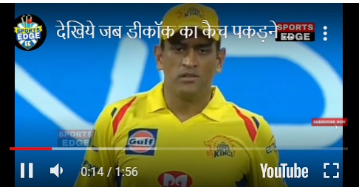
To watch a video just click on the YouTube icon. User can pause, expand or mute the video as per the need.

Slide 24

Future Scope
We can store the keywords search history of the user and can show them results based on the history.
A common platform can be made for all the OTT's.
Recommendations based on the group of friends (Friends Recommendation System).

Slide 25

Questions

